Slide 1
L.O: To know about physical and emotional changes during puberty.
We will be thinking about:
What puberty is.
How girl’s and boy’s bodies change physically during puberty.
How girl’s and boy’s bodies change emotionally during puberty.
The importance of looking after our bodies.

Slide 2
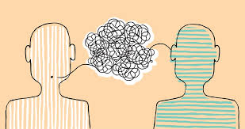
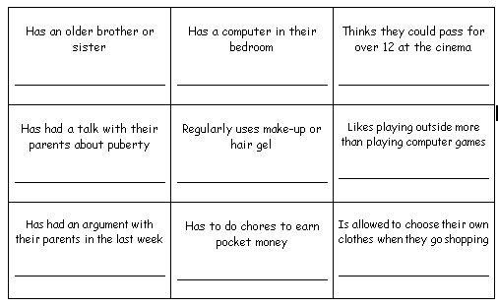
What’s our starting point?
GROWING UP BINGO!
Find someone in your class for each of the statements and write their name.
You must have a different name for each statement.
The winner is the first person to complete the grid.
.

Slide 3
GROWING UP BINGO!
You are all growing up!
With growing up comes new FREEDOMS and RESPONSIBILITIES!
.

Slide 4
STAND UP!
As I ‘quick-fire’ reveal words related to puberty, girls stand up if it is a ‘girl thing’, boys stand up if it is a ‘boy thing’ and all stand up if it is an ‘everyone thing’.
Notes:
Puberty is when a person’s body changes from being a child to being an adult. → True During puberty the body grows quickly. It is caused by changes in something called hormones. These are chemicals that send messages around the body.
Puberty starts at the same time for everyone. → False Puberty starts at different times between ages 8 and 13 in females, and ages 9 and 15 in males. It starts when the body is ready, a bit like losing your milk teeth.

Slide 5
STAND UP!
VOICE BREAKS
GROWING TALLER
TAMPON
MENSTRUATION
FACIAL HAIR
HORMONES
UNDERARM HAIR
FEELING MOODY
WET DREAMS
Notes:
Puberty is when a person’s body changes from being a child to being an adult. → True During puberty the body grows quickly. It is caused by changes in something called hormones. These are chemicals that send messages around the body.
Puberty starts at the same time for everyone. → False Puberty starts at different times between ages 8 and 13 in females, and ages 9 and 15 in males. It starts when the body is ready, a bit like losing your milk teeth.

Slide 6
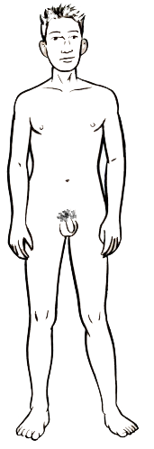
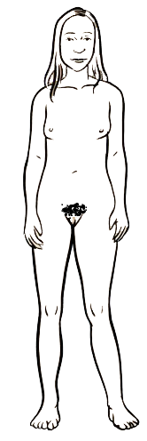
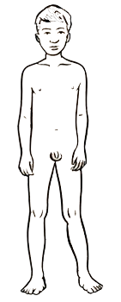
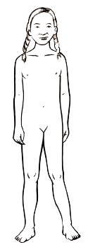
The changing body
Remember, these are the sorts of physical changes you are likely to go through during puberty.
Males:
Females:
Muscle increases
Penis and testicles grow
Grow pubic hair
Grow taller
Get spots and sweat more
Get oilier skin and hair
Get a deeper voice
Grow breasts
Hips and waist change shape
Grow pubic hair
Grow taller
Get spots and sweat more
Get oilier skin and hair
Get a deeper voice

Slide 7
True or false?
Read the statements below and decide if you think they are true or false.
Click on the statement to reveal the correct answer.
True
During puberty the body grows quickly. It is caused by changes in something called hormones. These are chemicals that send messages around the body.
Puberty is when a person’s body changes from being a child to being an adult.
False Puberty starts at different times between ages 8 and 13 in females, and ages 9 and 15 in males. It starts when the body is ready, a bit like losing your milk teeth.
Puberty starts at the same time for everyone.
Notes:
Puberty is when a person’s body changes from being a child to being an adult. → True During puberty the body grows quickly. It is caused by changes in something called hormones. These are chemicals that send messages around the body.
Puberty starts at the same time for everyone. → False Puberty starts at different times between ages 8 and 13 in females, and ages 9 and 15 in males. It starts when the body is ready, a bit like losing your milk teeth.

Slide 8
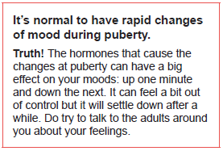
True or false?
Read the statements below and decide if you think they are true or false.
Notes:
Puberty is when a person’s body changes from being a child to being an adult. → True During puberty the body grows quickly. It is caused by changes in something called hormones. These are chemicals that send messages around the body.
Puberty starts at the same time for everyone. → False Puberty starts at different times between ages 8 and 13 in females, and ages 9 and 15 in males. It starts when the body is ready, a bit like losing your milk teeth.

Slide 9
What feelings might a person experience during puberty?
FEELINGS
Notes:
Puberty is when a person’s body changes from being a child to being an adult. → True During puberty the body grows quickly. It is caused by changes in something called hormones. These are chemicals that send messages around the body.
Puberty starts at the same time for everyone. → False Puberty starts at different times between ages 8 and 13 in females, and ages 9 and 15 in males. It starts when the body is ready, a bit like losing your milk teeth.

Slide 10
All of these feelings are completely normal to experience during puberty.
More sensitive
Teary
FEELINGS
Mood swings
(happy/sad, up/down)
Conflicting thoughts
(changing your mind)
Uncertain
Self-conscious
Frustrated/angry

Slide 11
What can you do to cope with all of these feelings?
Exercise
TALK to someone you trust!
COPING WITH FEELINGS
Do things you enjoy
Any more ideas?
Spend time with friends and family
Keep positive
Accept your feelings – it’s OK to feel like you do!

Slide 12
Remember!
If you feel worried about puberty or what you have learned during this session, talking to an adult you trust is one of the best ways to find help.
If you want to talk to someone other than a parent:
ChildLine can help.
See: https://www.childline.org.uk/get-support/
Or phone 0800 1111
Talk to a trusted adult at home
ChildLine: www.childline.org.uk
0800 1111

